Slide 1

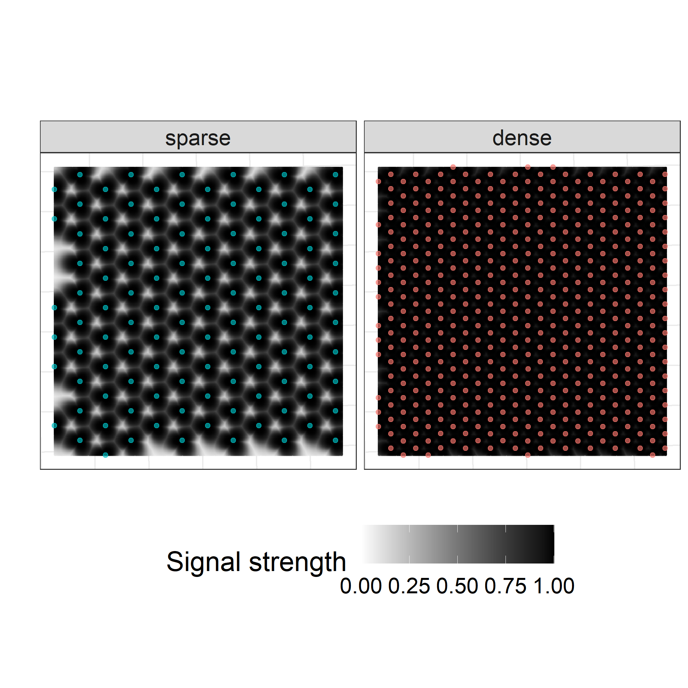
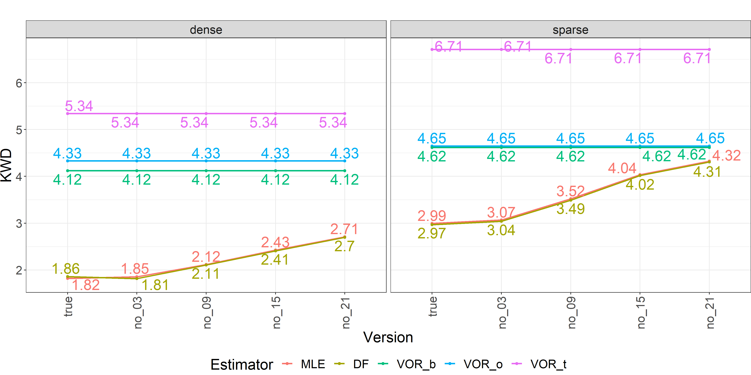
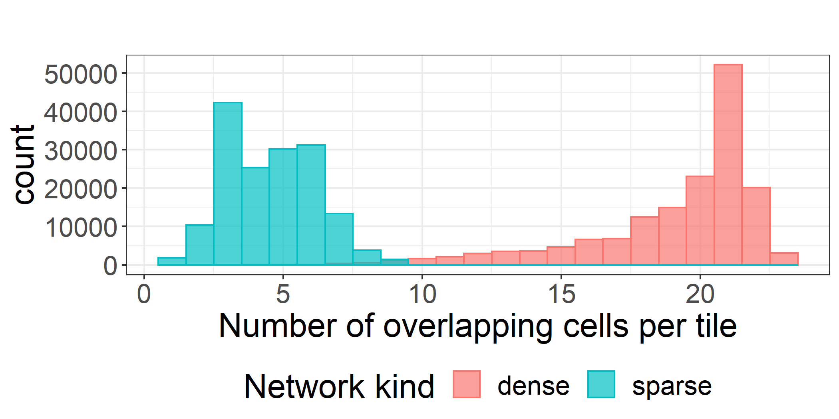
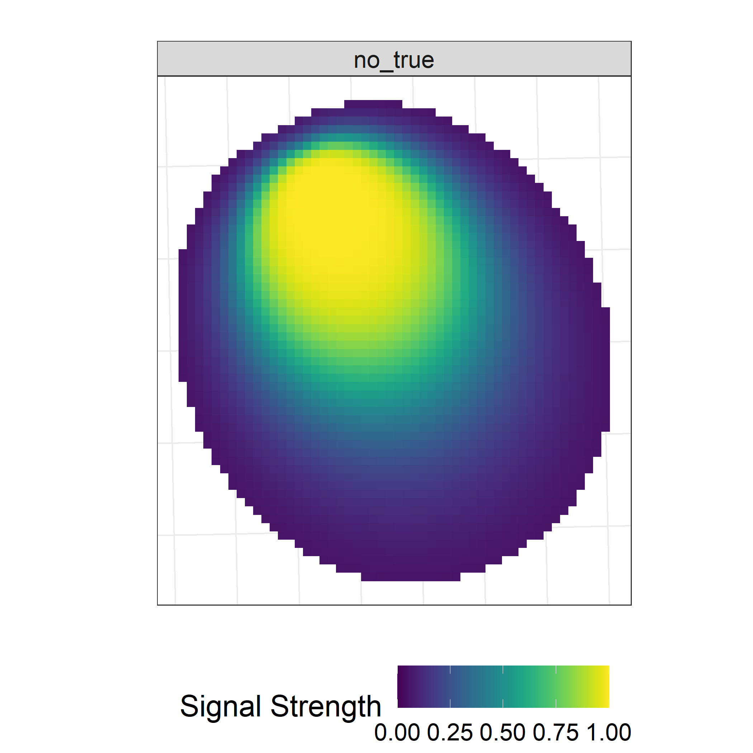
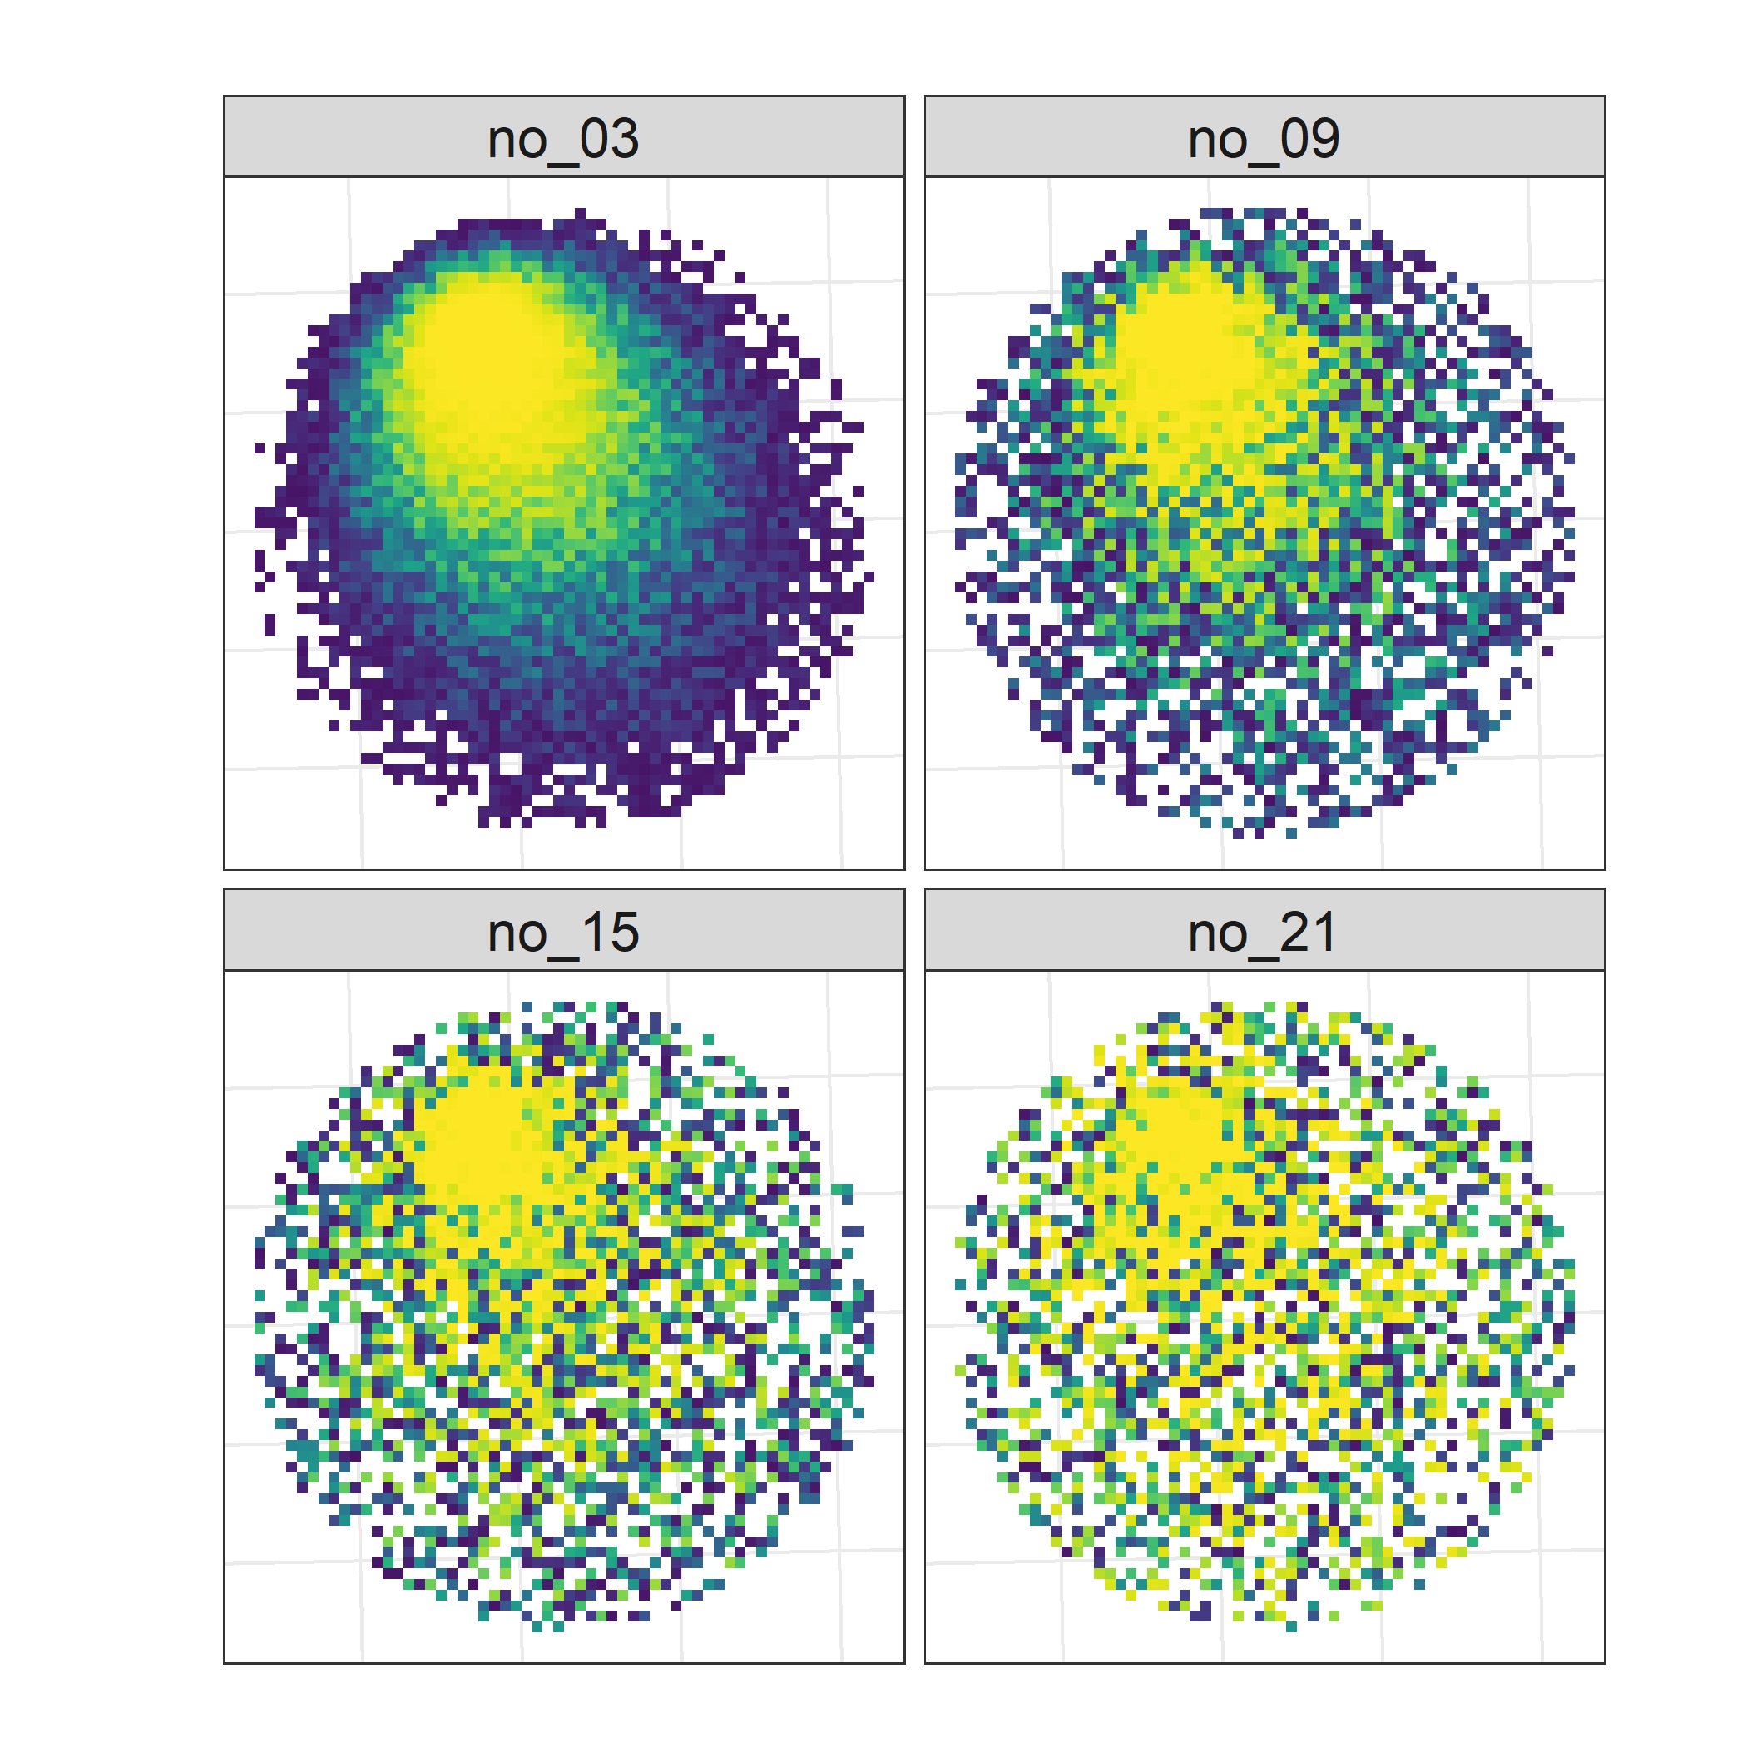
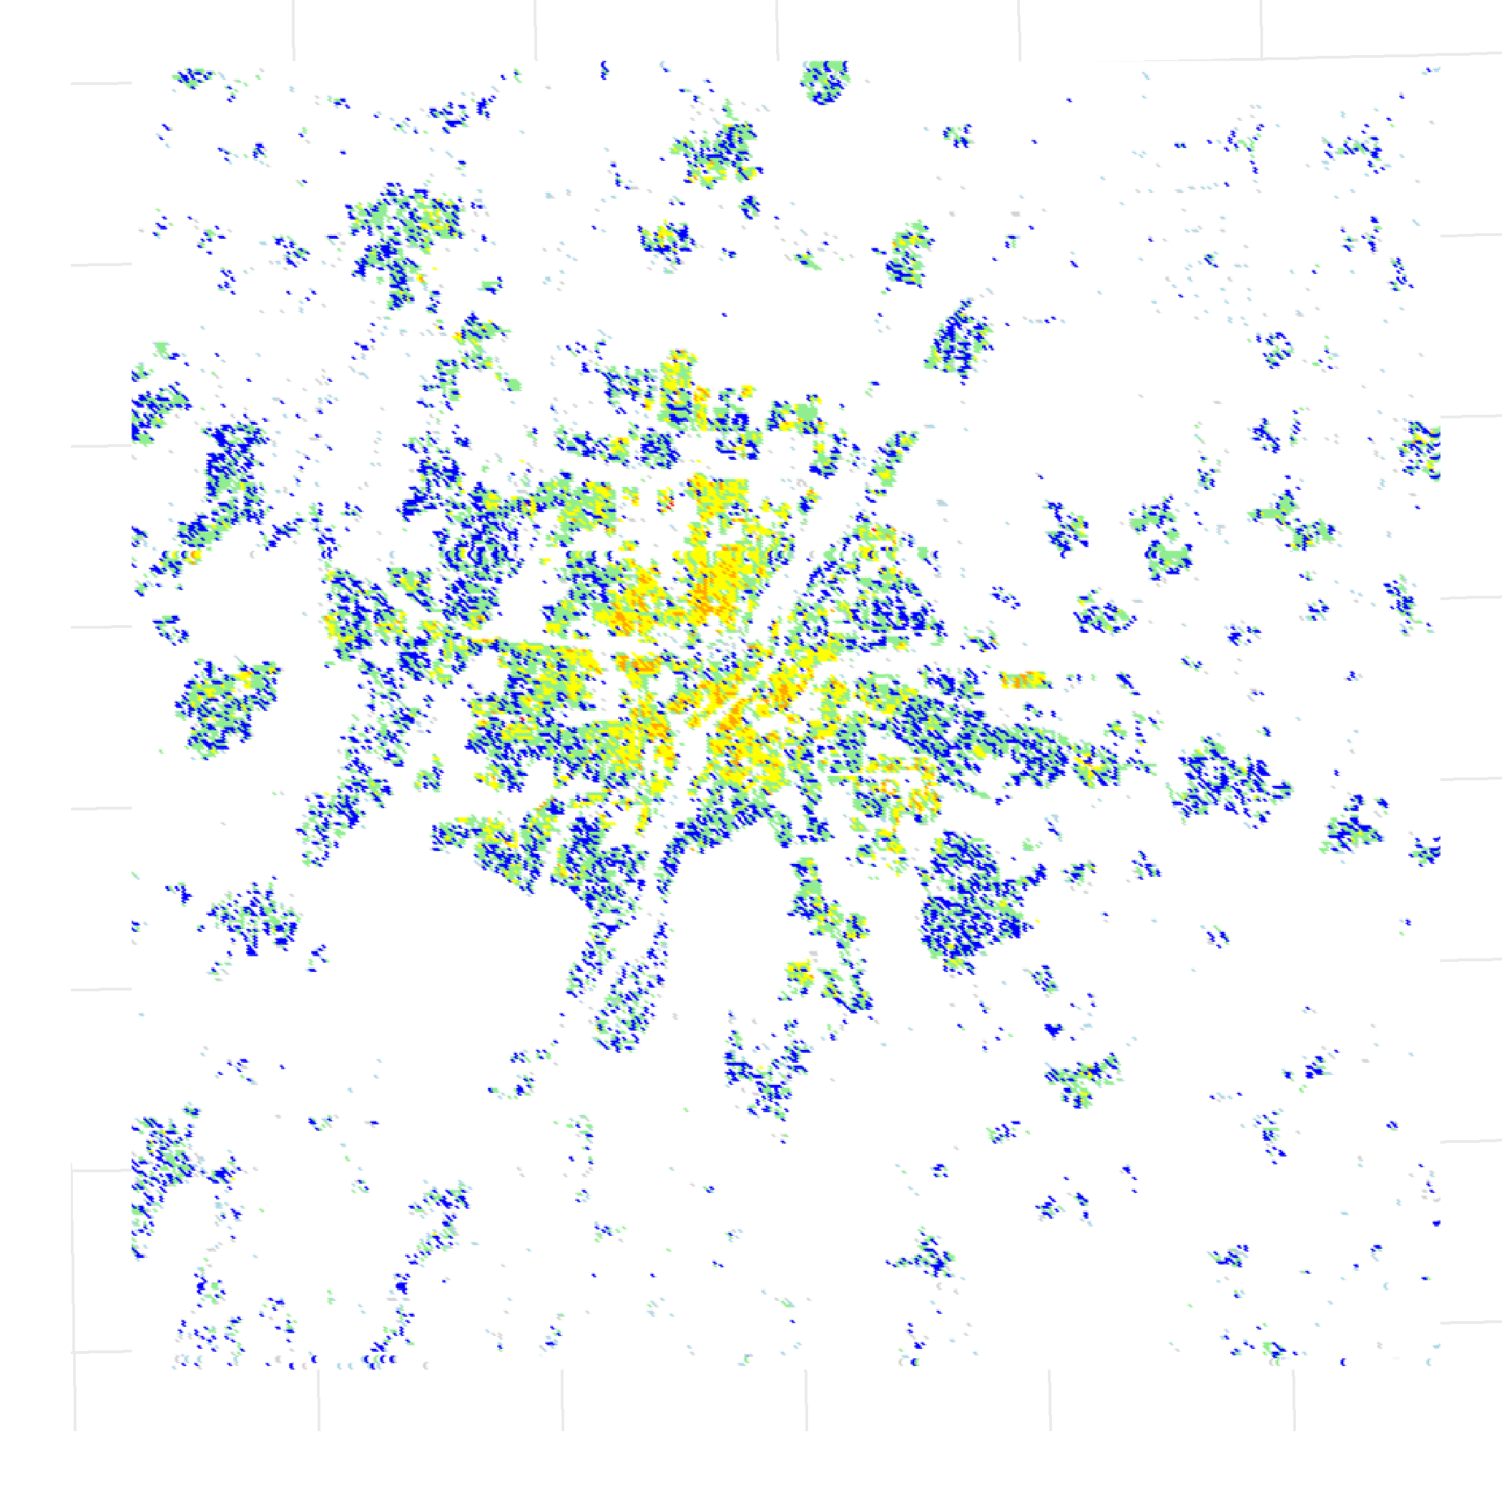
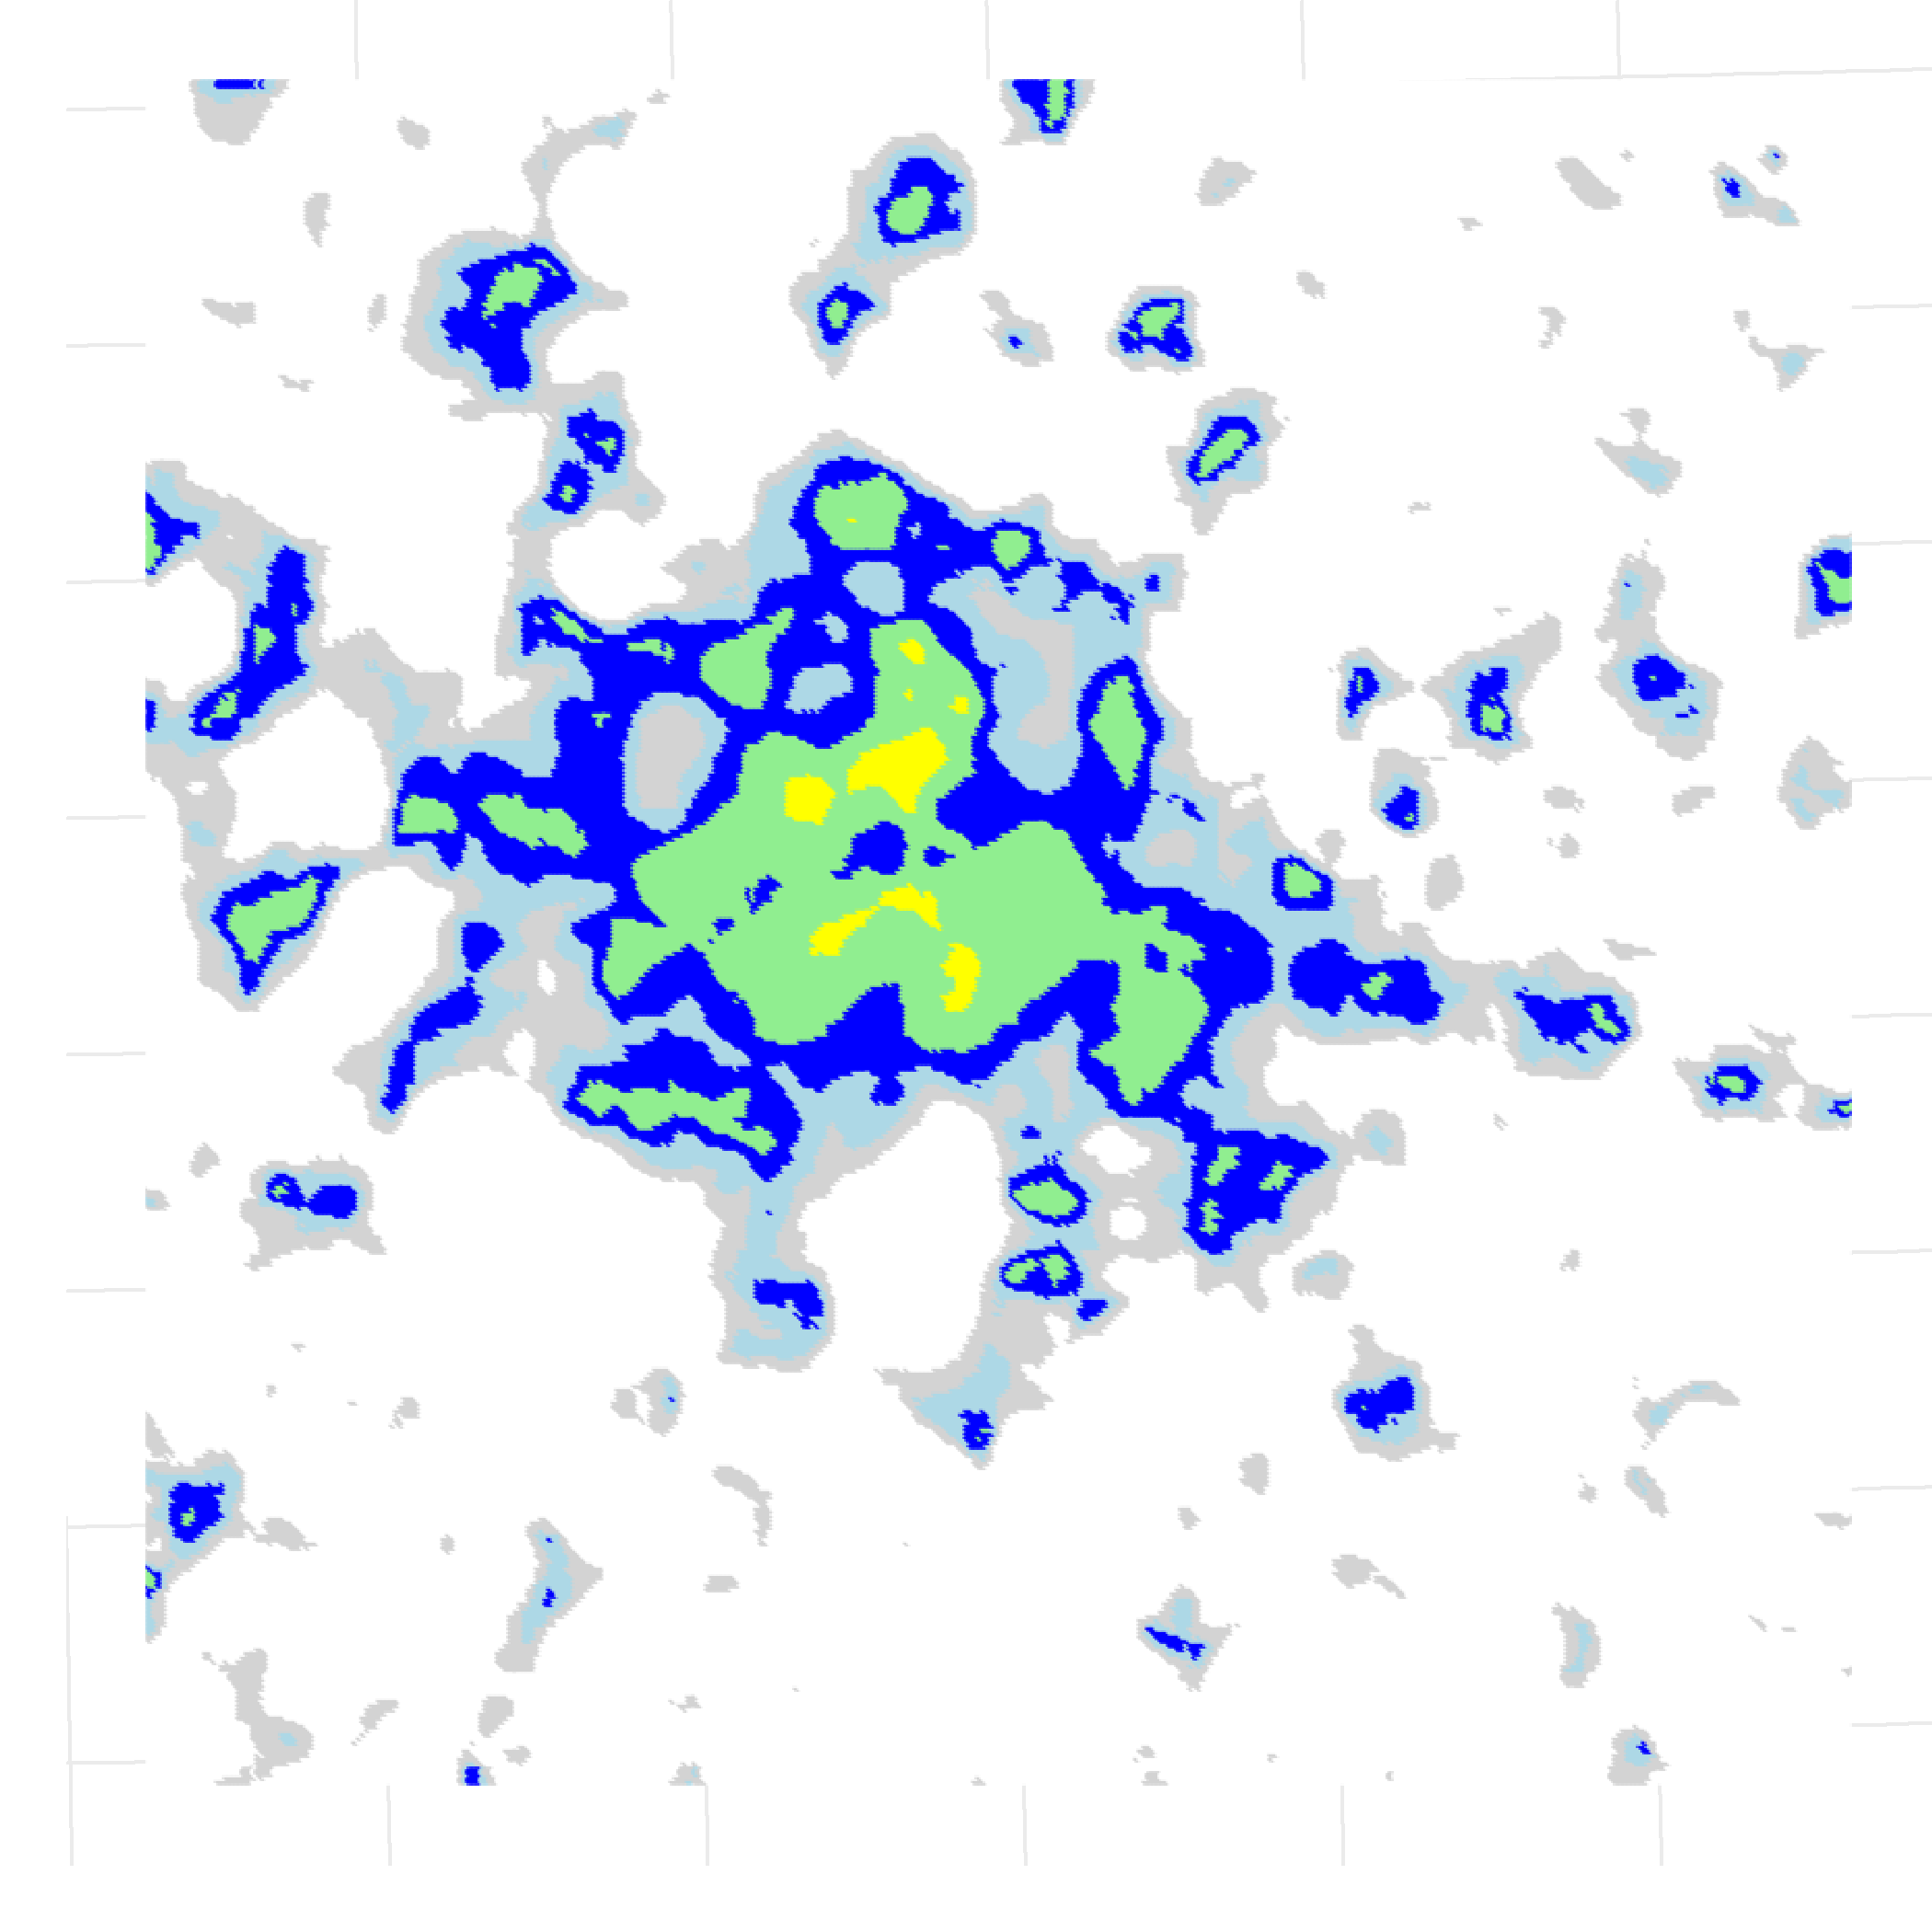
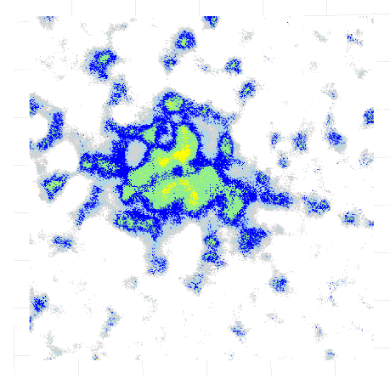
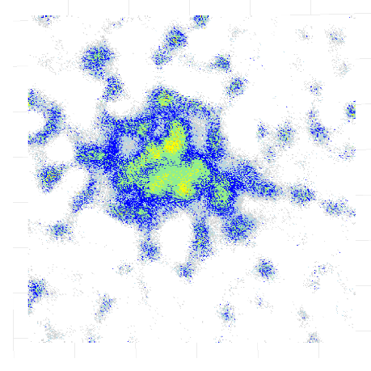
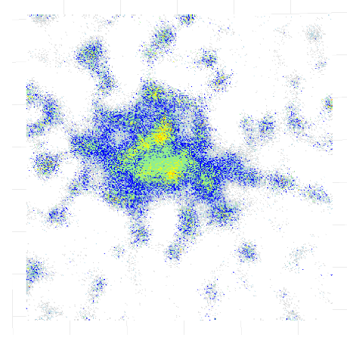
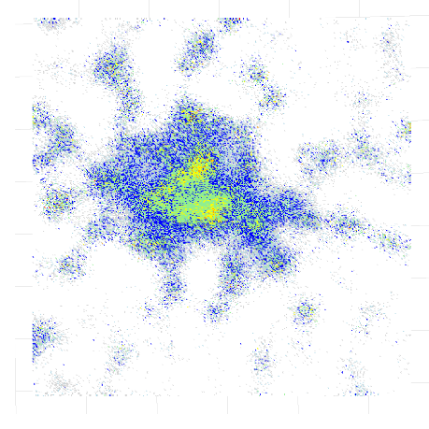
A sensitivity analysis concerning spatial density estimation with MNO data
Repository and references
Authors: Marco Ramljak¹, Fabio Ricciato², Peter Lugtig³
(1) Corresponding author (m.l.ramljak@students.uu.nl), Utrecht University, (2) Eurostat, (3) Utrecht University
Research Intent
Simulation Study Design
Mobile Network Operator (MNO) data offer a rich source for estimating the spatial distribution of mobile phones at a given point in time. We compare two kinds of estimation strategies: (1) the traditional Voronoi tessellation and variants thereof, which exclusively assume that every mobile phone connects to its nearest cell (deterministic), (2) recently introduced estimators that are based on radio propagation modeling (RPM) through additional cellular network information (probabilistic). We know that RPM pays off in terms of spatial accuracy if the model information is of perfect quality, however, the question remains how high-quality does the model information need to be?
For this, we have developed two research questions:
RQ1: How robust are estimation strategies to network model mismatching errors (information quality)?
RQ2: How sensitive are estimation strategies to network characteristics, such as cell density?
100m x 100m grid (1,600 km², right-tailed population distribution, Munich)
For RQ2, two synthetic cellular networks (dense and sparse)
Mimicking cell counters and developing the generative RPM
Toyworld Generation
Estimation
Evaluation
Voronoi estimators: Tower (VOR_t), antenna offset (VOR_o), barycenter (VOR_b)
RPM estimators: MLE, DF
For RQ1, model mismatch introduced to develop multiple RPMs for estimation
Kantorovitch-Wasserstein distance (KWD) to measure the degree of horizontal spatial error
Spatial density maps
Key Results
A) Network characteristics
To reserach the effect of network characteristics, we developed two networks of different directional cell-density levels (Fig. 1). Each network leads to a different distribution of overlapping cells per 100m x 100m tile (Fig. 2).
Fig. 1 Two synthetic cellular networks
Fig. 2 Cell overlap per tile
Fig. 4 KWD values for all simulated versions
B) Model mismatch To research the effect of network information quality, we use the generative RPM as a basis and introduce spatially sensitve, random noise to create multiple RPMs for estimation. These noised distortions resemble shaded versions of information quality.
C) Evaluation Lower KWD values resemble higher similarity to the ground truth density in terms of spatial accuracy. Even in the sparse network scenario the RPM estimators with severely noised RPMs perform much better (Fig. 4). In Fig. 5 one can visually compare the similarity between the ground truth spatial density and the selected MLE estimated spatial densities.
Generative RPM
Ground truth spatial density
MLE - Generative RPM
MLE – no_03
MLE – no_09
Model mismatch
?
MLE – no_15
MLE – no_21
Fig. 3 Model mismatch on exemplary cell profile through random noise
Fig. 5 Selected spatial density maps (comparing ground truth with MLE estimations of the dense network)
Key Takeaways
For RQ1: Even with severe model mismatch, RPM estimators lead always to spatially more accurate results than any Voronoi estimator.
For RQ2: Higher network density offers more information and can therefore lead to spatially more accurate results than sparse networks. RPM estimtators utilize this information better than Voronoi estimators.
RPM is a complex task, however, in terms of spatial accuracy, it pays off because it allows to model overlapping cells. Our research shows that RPM estimators perform well under different network characteristics and are robust to severe model mismatching errors. Therefore, RPM estimators should be prefered as they utilize various information levels much better than Voronoi estimators. This research project will be extended through more networks (e.g. network layers) and mismatch versions (e.g., quantization, blurring). Further description of the estimators here: arxiv.org/abs/2009.05410
Notes:
Prints as 33.1 x 46.8 (A0) at 100%. When printed using the library printing service, this will require trimming from 36 inch wide paper. To fill 36 inch paper roll, scale to 108.5% (prints as ~ 36 X 51).

